Slide 1

Confidence Intervals and Effect Sizes
Reading: 5.5
exercises: none
Assigned: hw 10
Producer: dr. mario
img credit: alex riegert-waters

Slide 2
Recall ANOVA F-test
Question: What do we learn if we achieve significance?
Follow-up Questions:
How much uncertainty do we have regarding the group means?
Which group means are different?
Do the differences matter?
$$H_{a}:μ_{i}≠μ_{j} for some i≠j$$

Slide 3
Example: Grades on Different Exams
There are Four Different Exams (1, 2, 3, 4)
There are Five Students (Barb, Betsy, Bill, Bob, Bud)
Each Student Takes All Four Exams
Question: Is there a significant difference in the average grade among the five individuals?

Slide 4
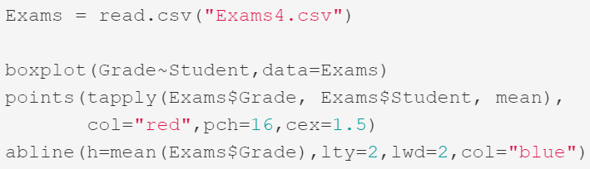
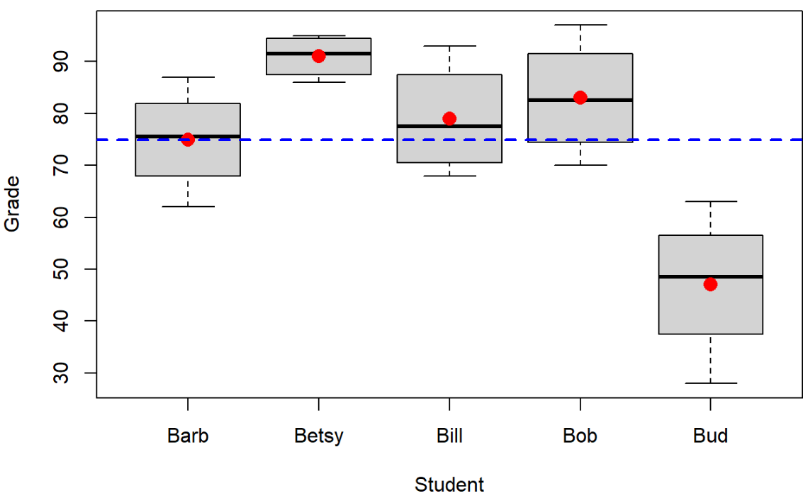
Example: Grades on Different Exams
Plot of Grades for all Four Students

Slide 5
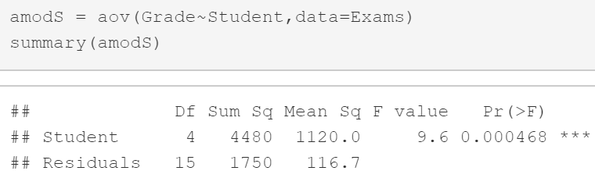
Example: Grades on Different Exams
ANOVA Model and Output
We Have Evidence that At Least One Student Has an Average Grade that is Different Than the Average Grade of Another Student

Slide 6

Estimating Group Means
Confidence Interval For Group Mean
Works When Different Groups Have Different Sample Sizes
Groups With More Data -> Smaller Confidence Intervals
MSE is Fixed For All Groups Because of Homoscedasticity Condition
$${\overline{y}}_{i}±t_{0.975,n−K} \sqrt{\frac{MSE}{n_{i}}}$$

Slide 7
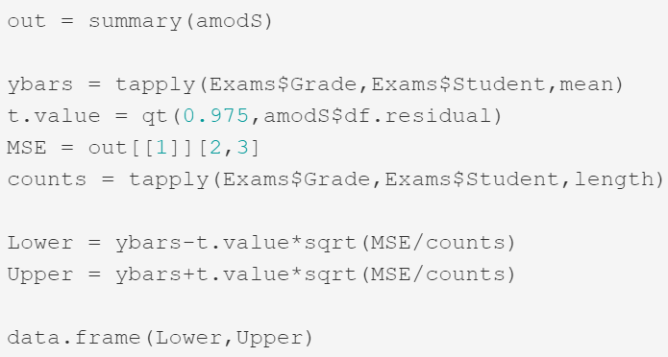
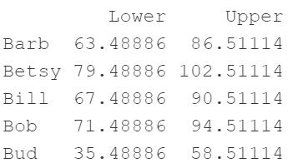
Example: Grades on Different Exams
Confidence Intervals for Average Grade for Each Student

Slide 8


Estimating Differences in Group Means
Confidence Interval For Differences Between Group Means
Works for Comparing the Two Groups
Use this Interval to Estimate $μ_{1}−μ_{2}$
If 0 is in the Interval -> No Evidence that $μ_{1}−μ_{2}≠0$
$${(\overline{y}}_{1}−{\overline{y}}_{2})±t_{0.975,n−K} \sqrt{\frac{MSE}{n_{1}}+\frac{MSE}{n_{2}}}$$

Slide 9
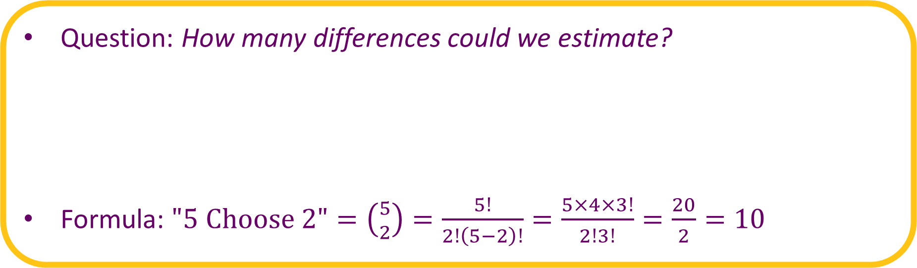
Example: Grades on Different Exams
Question: How many differences could we estimate?
Formula: $"\text{5 }\text{Choose}\text{ 2"}=\left({5 \atop 2}\right)=\frac{5!}{2!\left(5−2\right)!}=\frac{5×4×3!}{2!3!}=\frac{20}{2}=10$
Barb vs. Betsy Barb vs. Bill Barb vs. Bob
Barb vs. Bud Betsy vs. Bill Betsy vs. Bob
Betsy vs. Bud Bill vs. Bob Bill vs. Bud
Bob vs. Bud

Slide 10
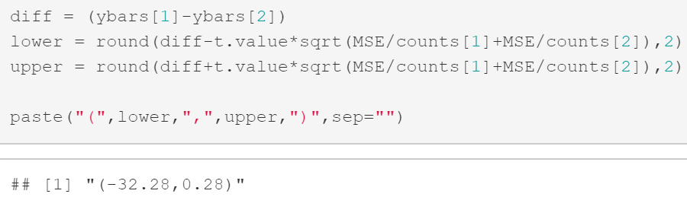

Example: Grades on Different Exams
Barb vs Betsy
Barb vs Bud

Slide 11
Effect Size
Based on the ANOVA (Effects) Model
“Statistically Significant” is Often Misleading
Example:
Hiring a Tutor to Help You Increase Your Grade in the Class
Question: Would You Hire That Tutor if You Believe that Tutor Can Increase Your Grade in the Class by 1%?
$$Y=μ+α_{i}+ε$$

Slide 12
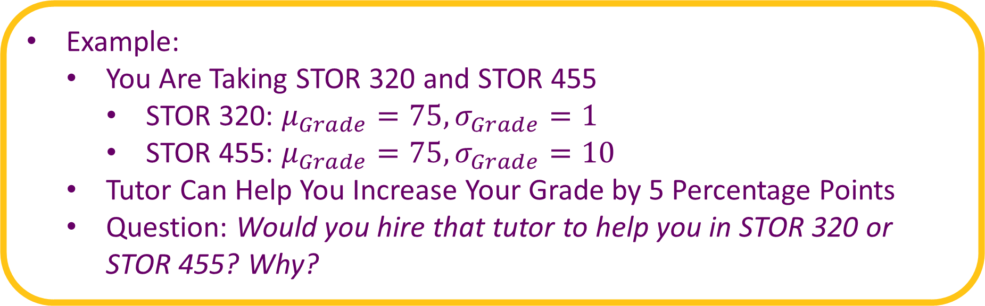
Effect Size
Example:
You Are Taking STOR 320 and STOR 455
STOR 320: $μ_{Grade}=75, σ_{Grade}=1$
STOR 455: $μ_{Grade}=75, σ_{Grade}=10$
Tutor Can Help You Increase Your Grade by 5 Percentage Points
Question: Would you hire that tutor to help you in STOR 320 or STOR 455? Why?

Slide 13


Effect Size
Effect Size is Based on a Ratio of the Estimated Effect and RMSE
Formula for Single Group
Formula for Difference Between Two Groups
$$D_{i}=\frac{{\hat{α}}_{i}}{RMSE}=\frac{{\overline{y}}_{i}−\overline{y}}{RMSE}$$
$$D_{ij}=\frac{{\overline{y}}_{i}−{\overline{y}}_{j}}{RMSE}$$

Slide 14
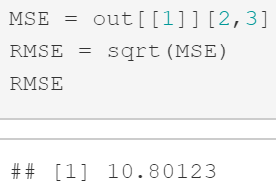
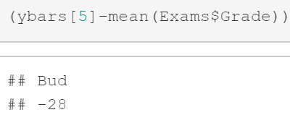
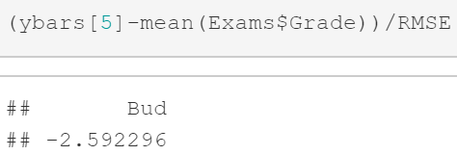
Example: Grades on Different Exams
RMSE of Model
Effect Size of Bud
“Typical” Difference Between Points Scored and Expected Points Scored
The Average Grade Drops by About 2.59 Standard Deviations if You Are Bud

Slide 15
Thank You
Make Reasonable Decisions

